Slide 1

Lisburn Visitors
Overview to LCCC Corporate Team - September 2016
Albert Hamilton

Slide 2
Recap on Objectives & C-COM
Objectives – Performance Evaluation Framework
  Understand the consumers living within Lisburn City catchment
  Understand visitors coming to Lisburn City
  Understand visitor behaviour
  Understand visitor opinions to derive effective intervention
Methodology: Continuous Consumer Monitoring (C-COM)
  Weekly sampling
  Monthly reporting
  Establishes the most accurate visitor baseline
  Identifies emerging trends early
The C-COM programme commenced in July.
C-COM gathers data from visitors to Lisburn city centre every week of the year. Doing this allows us to compile a dynamic catchment profile, to understand where visitors are coming from and when changes in their visiting behaviour occur.
In this way, C-COM is used to understand how events and marketing initiatives influence consumer use of the town centre.

Slide 3
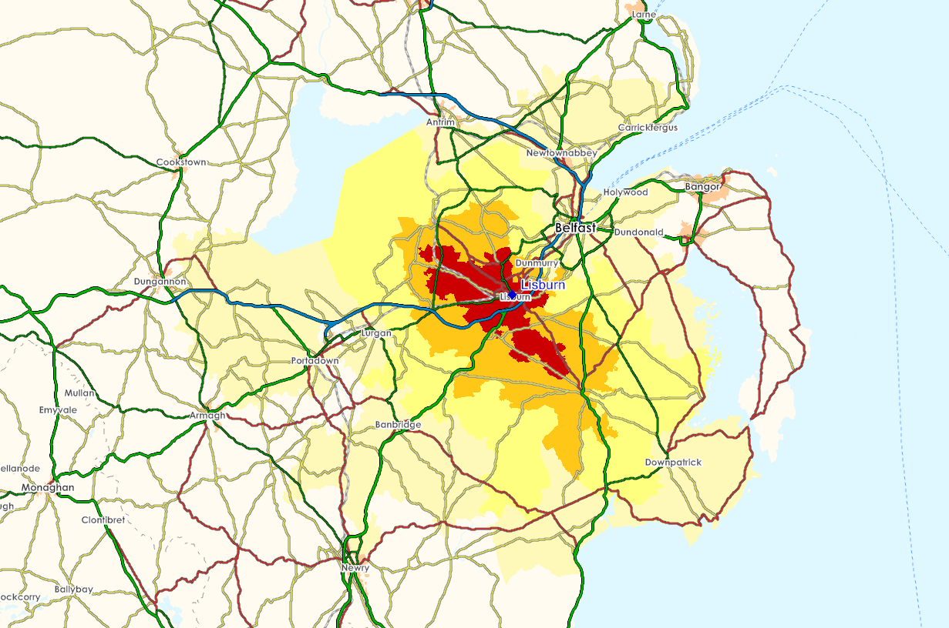
Consumers Living in Catchment
Lisburn is underperforming within its catchment boundaries.
A market share of at least 50% would be expected within the primary catchment, and 25% in the secondary catchment.
Achieving this would draw an additional £19m spend per annum on comparison goods in the city.
ACORN Category | Lisburn | NI
1 – Affluent Achievers | 22.7% | 17.4%
2 – Rising Prosperity | 9.4% | 3.5%
3 – Comfortable Communities | 27.4% | 44.2%
4 – Financially Stretched | 22.6% | 21.7%
5 – Urban Adversity | 17.9% | 13.2%
Catchment | Comparison Spend | Market Share
Primary | £67.9m | 44.2%
Secondary | £33.4m | 19.2%
Tertiary | £19.9m | 6.6%
Quaternary | £13.3m | 0.8%
Total | £161.0m | 26.3%

Slide 4
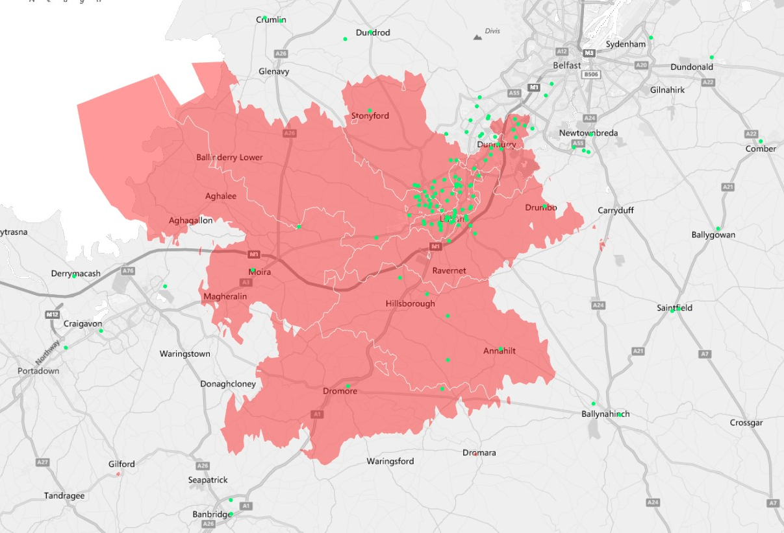
Visitors coming to Lisburn City
Visitors predominantly within Lisburn’s pre-RPA catchment.
Little ingress into Castlereagh evident thus far.
Castlereagh East & Castlereagh South represent 40k population – 31% of Council total.
Castlereagh South is largest District Electoral Area by population.
Note that a summer sample is as important as other months.
BT28 3
BT28 2
BT67 0
BT27 5
BT26 6
BT25 1
Sector | Local area | August
BT27 4 | Harmony Hill, Lambeg | 16.2%
BT28 1 | City Centre, Moira Road | 13.5%
BT28 3 | Milltown, Derriaghy | 13.5%
BT28 2 | Ballinderry, Knockmore | 12.6%
BT27 5 | Ravernet, Drumbo | 7.2%

Slide 5
Understanding visitor behaviour
For every 11 trips to Lisburn City, visitors make 6 other trips to Belfast, Sprucefield or Boucher Road.
In later months we will understand what proportion of this is gain to the city (shoppers coming from other catchments) and what proportion is leakage (Lisburn catchment to other areas).
Visitors are engaging :
Retail interaction is strong at 74%
Food and beverage interaction is excellent at 46% (expected 30%)
Choice of Restaurants at 70% is better side of average compared to other locations.
Lisburn City Centre Ratings
Choice of Shops
Interaction & Spend | July / August
Rate of Retailer Interaction | 74%
Average Retail Spend | £60
Rate of Food & Beverage Interaction | 46%
Average Food & beverage Spend | £13.38
Overall Average Spend | £55
66
Choice of Restaurants
72
Choice of Entertainment Options
78
Cleanliness of the City Centre
70

Slide 6
Understanding visitor opinions
Current Net Promoter Score = minus 11 (poor)
  Promoters = 20, Passives = 48, Detractors = 32
Biggest reported problem for visitors is Choice of Shops (corroborated by correlation)
  Unsure as yet if this based on:
    Gradual decline
    Consumer mismatch
    Failed promise (over-promotion)
Shops of strategic significance (destination stores) are:
  Green’s
  Primark
  Boots
  Poundland
  Menarys
Ratings Attribute | Correlation to NPS
Range of shops | 0.69
Range of Restaurants | 0.30
Range of Entertainment | 0.30
Cleanliness | 0.52

Slide 7
Key emerging points so far
Little evidence of Castlereagh accessing Lisburn City Centre – despite it representing 30% of Council population
Strong use of Food and Beverage offer in Lisburn City – despite ‘average’ ratings of choice and offer
Choice of shops in Lisburn a threat to maintaining existing visitor base
Increasing engagement to average levels would bring £19m comparison goods spend per year
Suggested next steps – for consideration
Continue to monitor visitor base
‘Lisburn-avoider’ study to qualify their perceptions of Lisburn and reasons for going elsewhere
‘Multiple-ready’ document to alert brands to Lisburn’s professional visitor management
Travel times:
Carryduff to Belfast City = 26 minutes
Carryduff to Lisburn City = 21 minutes
Four Winds to Belfast City = 21 minutes
Four Winds to Lisburn = 22 minutes
Purdysburn to Belfast City = 20 minutes
Purdysburn to Lisburn = 20 minutes

Slide 8
Disclaimer
No part of this report may be reproduced or transmitted in any form or by any means, or stored in any retrieval system of any nature without the prior written permission of CARD Group.
CARD Group warrants that reasonable skill and care has been used in preparing this report. Notwithstanding this warranty CARD Group shall not be under liability for any loss of profit, business, revenues or any special indirect or consequential damage of any nature whatsoever or loss of anticipated saving or for any increased costs sustained by the client or his or her servants or agents arising in any way whether directly or indirectly as a result of reliance on this publication or of any error or defect in this publication.
CARD Group makes no warranty, either express or implied, as to the accuracy of any data used in preparing this report nor as to any projections contained in this report which are necessarily of a subjective nature and subject to uncertainty and which constitute only CARD Group's opinion as to likely future trends or events based on information known to CARD Group at the date of this publication.
This publication is intended for use only by the client for whom it was prepared and shall not be quoted or made public in any way without CARD Group's written consent. CARD Group shall not in any circumstances be under any liability whatsoever to any other person for any loss or damage arising in any way as a result of reliance on this publication.
This publication is made available to you subject to CARD Group's terms of engagement to which your attention is hereby drawn.
For further information please contact:
Albert Hamilton
Chief Executive
albert.hamilton@card-group.com
+44 (0) 78 1211 1262
Niall Murphy
Senior Analyst
niall.murphy@card-group.com
+44 (0) 78 4939 6385
CARD Group head office
hello@card-group.com
+44 (0) 28 9447 7463

